Slide 1
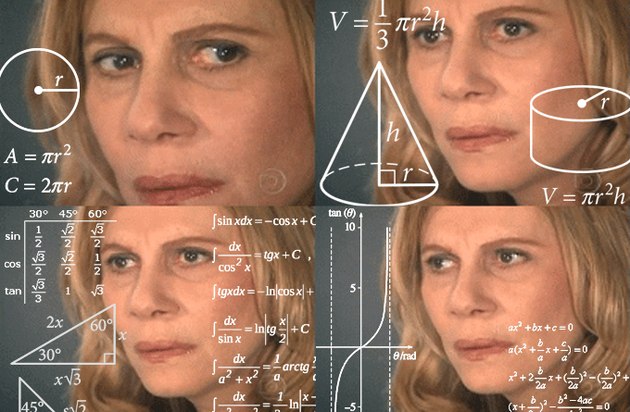
Chapter 01 Science Inquiry
Data and Analysing Results

Slide 2

Date: | Human Biology Year 12 ATAR
Do Now Complete the past exam question given, under test conditions (not for actual marks) Lesson Agenda 1: Do Now 2: Scientific Method in Human Health – Data collection and analysis 3: Work on Review Worksheet 4: Lesson summary and wind-up Suggested Study Compulsory: Complete review worksheet, mark and correct using answer key on Connect. Read through today’s notes and textbook section NEXT LESSON Reporting on Scientific Investigations Practice Examples – Second Hand Data analysis | Learning Aims: Describe different methods and aspects of data analysis used in Human Health research.
 | Key Vocabulary Data Confidence Level Confidence Interval Mean Median Range

Slide 3
Quantifying Results
Qualitative data:
observations that do not involve measurement
Eg: “Several respondents reported feeling better after receiving the medication.”
Quantitative data:
Observations with a numerical value, that can be measured
Eg: “On average, the experimental group experienced a 20 point drop in systolic blood pressure after receiving the medication.
Try to get quantitative data where possible

Slide 4
Errors in Data
Error: in some cases, mistakes, in others:
“a deviation from the result that would have been obtained under perfect conditions”.
Variations in sample and/or measurement process can cause “measurement error”.
Not necessarily a “mistake”, may be due to limitations of equipment
Large sample sizes can help.

Slide 5
Limitations of Data
Can only draw conclusions that are supported by the data.
Beware of other, uncontrolled factors that can affect the data.
Media reporting often over-simplifies research data, drawing misleading conclusions.

Slide 6
Secondary Data
Data collected by researchers, then re-used or re-analysed by other researchers: “second hand”

Slide 7
Confidence Interval
Used to indicate reliability of data.
Range of values in which the true value is likely to occur, within a margin of error.
Eg: If a study shows that 53% of people plus or minus 1.5% experience a drop in blood pressure after taking Pressurego, the confidence interval is 51.5-54.5%
Used alongside Confidence Level
Confidence Level
Used alongside Confidence Interval
Calculated using statistical analsysi.
The % of cases which fall within the confidence interval
Eg: a 95% confidence level means that, if you repeat the experiment multiple times, the range of values you obtain will fall within the confidence interval 95% of the time.
So, if you complete the Pressurego experiment multiple times, the proportion of people who experience a drop in blood pressure will be between 51.5 and 54.5, 95% of the time.
A greater than 95% confidence level indicates that the results are reliable, and is considered the minimum acceptable confidence level in research.

Slide 8
Processing Data
Mean:
Add values, then divide by number of values.
Can be strongly affected by outliers.
Can remove outlier if very clearly resulting from error.
Median:
Middle value in a set of numbers
Reduces effect of outliers
Useful for some types of data

Slide 9
Range:
Difference between largest and smallest value
Gives an idea of how “clustered together” results are.
In formal scientific research, range can be measured as standard deviation or quartiles.
Ratios and Rates
Numerical statement of how one variable relates to another.

Slide 10
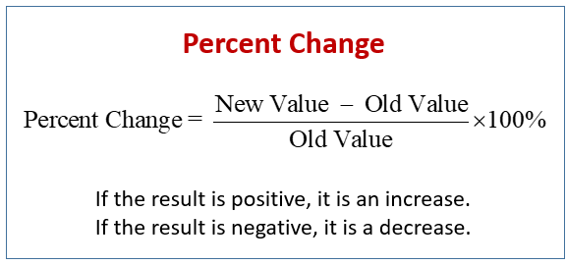
Percentages:
Used to express how large part of something is.
/100
Percentage Change:
Good way to show change over time.
Negative = decrease
Positive = increase
Frequency:
Number of times an event occurs
Probability:
The chance that a particular event will occur.

Slide 11
Presentation of Data
Tables:
Title, stating variables
Columns, for IV and DV
Headings on columns, including units
Graphs:
Pictorial way of presenting data
Title, labelled axes, units, correct plotting

Slide 12
Models:
A simplified representation of an idea or process, used to predict what would happen.
Flow Charts
A diagram showing steps involved in a process.

